Slide 1
Teradata Training
Day 11 -- 11/29/2018

Slide 2
Topics
Handling with Null Values
Joins
Inner Join( Self join)
Outer Join(Left , Right, Full)
Cross join (Cartesian product join)
Merge Join
Nested Join
Hash Join
Exclusion Join

Slide 3

JOINS

Slide 4
Joins
Joins | Definition
Inner Join(Self‑Join) | Inner Join combines records from multiple tables and returns the values that exist in both the tables.
OUTER JOIN | Left Outer Join Right Outer Join Full Outer Join
Left Outer Join | returns all the records from the left table and returns only the matching records from the right table.
Right Outer Join | returns all the records from the right table and returns only matching rows from the left table.
Full Outer Join | combines the results from both LEFT OUTER and RIGHT OUTER JOINS. It returns both matching and non-matching rows from the joined tables.

Slide 5
Joins
Joins | Definition
Cross Join (Cartesian Product Join) | joins every row from the left table to every row from the right table.
Merge Join | Merge join is a concept in which rows to be joined must be present in same AMP. If the rows to be joined are not on the same AMP, Teradata will either redistribute the data or duplicate the data in spool to make that happen based on row hash of the columns involved in the joins WHERE Clause.
Nested Join | Nested Join is one of the most precise join plans suggested by Optimizer .Nested Join works on UPI/USI used in Join statement and is used to retrieve the single row from first table . It then checks for one more matching rows in second table based on being used in the join using an index (primary or secondary) and returns the matching results.

Slide 6
Joins
Joins | Definition
Hash Join | Hash join is one of the plans suggested by Optimizer based on joining conditions. We can say Hash Join to be close relative of Merge based on its functionality. In case of merge join, joining would happen in same amp. In Hash Join, one or both tables which are on same amp are fit completely inside the AMP's Memory . Amp chooses to hold small tables in its memory for joins happening on ROW hash Advantage: 1. They are faster than Merge joins since the large table doesn’t need to be sorted. 2. Since the join happening b/w table in AMP memory and table in unsorted spool, it happens so quickly.
Exclusion Join | These type of joins are suggested by optimizer when following are used in the queries - NOT IN - EXCEPT - MINUS - SET subtraction operations

Slide 7
JOINS --- Syntax
Joins | Syntax
Inner Join | SELECT Emp.EmployeeNo, Emp.DepartmentNo, Sal.NetPay FROM testdb1.Employee Emp INNER JOIN testdb1.EmpSalary Sal ON Emp.EmployeeNo = Sal.EmployeeNo;
Self Join | SELECT Emp.EmployeeNO, Emp.Firstname, Dept.DepartmentNo FROM testdb1.Employee Emp JOIN testdb1.Employee Dept ON Emp.EmployeeNO = Dept.EmployeeNO;

Slide 8
JOINS -- Syntax
Joins | Syntax | Syntax
Left Outer Join | SELECT A.EmployeeNo, A.DepartmentNo, B.NetPay FROM testdb1.Employee A LEFT OUTER JOIN testdb1.Salary B ON A.EmployeeNo = B. EmployeeNo ORDER BY A.EmployeeNo; | SELECT A.EmployeeNo, A.DepartmentNo, B.NetPay FROM testdb1.Employee A LEFT OUTER JOIN testdb1.Salary B ON A.EmployeeNo = B. EmployeeNo ORDER BY A.EmployeeNo;
Right Outer Join | SELECT A.EmployeeNo, A.DepartmentNo, B.NetPay FROM testdb1.Employee A RIGHT OUTER JOIN testdb1.Salary B ON A.EmployeeNo = B. EmployeeNo ORDER BY A.EmployeeNo; | SELECT A.EmployeeNo, A.DepartmentNo, B.NetPay FROM testdb1.Employee A RIGHT OUTER JOIN testdb1.Salary B ON A.EmployeeNo = B. EmployeeNo ORDER BY A.EmployeeNo;

Slide 9
JOINS -- Syntax
Joins | Syntax | Syntax
Full Outer Join | SELECT A.EmployeeNo, A.DepartmentNo, B.NetPay FROM testdb1.Employee A FULL OUTER JOIN testdb1.Salary B ON A.EmployeeNo = B. EmployeeNo ORDER BY A.EmployeeNo; | SELECT A.EmployeeNo, A.DepartmentNo, B.NetPay FROM testdb1.Employee A FULL OUTER JOIN testdb1.Salary B ON A.EmployeeNo = B. EmployeeNo ORDER BY A.EmployeeNo WHERE A.EmployeeNo is null Or B.EmployeeNo is null;
Cross Join | SELECT A.EmployeeNo, A.DepartmentNo, B.EmployeeNo, B.NetPay FROM testdb1.Employee A CROSS JOIN testdb1.Salary B ; | SELECT A.EmployeeNo, A.DepartmentNo, B.EmployeeNo, B.NetPay FROM testdb1.Employee A CROSS JOIN testdb1.Salary B WHERE A.EmployeeNo = 101 ;

Slide 10
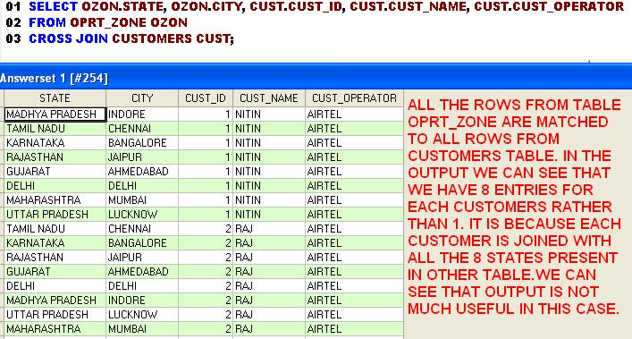
Cross join Live example

Slide 11
Subqueries
Subquery | Syntax
Subquery | SELECT EmployeeNo, NetPay FROM Salary WHERE NetPay = (SELECT MAX(NetPay) FROM Salary);
Subquery | SELECT EmployeeNo, NetPay FROM (SELECT * FROM Salary) A WHERE NetPay = (SELECT MAX(NetPay) FROM Salary);

Slide 12
Interview Questions
Difference between Union and Full outer join
Difference between left outer join and right outer join
Difference between Intersect and Except
Difference between Full outer join and Left outer join

